Slide 1
Session 19: Apps with networking
Code For Teens
TechKids

Slide 2
Previously on C4T
UI App

Slide 3
Agenda
App with networking
Object revisit
JavaScript Object (JSON) analysis
API
Demo
Requirement breakdown
Implementation

Slide 4
Object revisit

Slide 5
Object
Represent related but homogeneous items
var school = {
name: "techkids",
slogan: "codethechange",
year: 2015,
}

Slide 6
Object with Arrays inside
var school = {
name: "techkids",
slogan: "codethechange",
year: 2015,
courses: [
'Web full stack',
'Code Intensive',
'Code for teen basics'
]
}

Slide 7
Array of Objects
var schools = [
{
name: "Iliat",
slogan: "School of Change",
year: 2014,
},
{
name: "TechKids",
slogan: "Code the Change",
year: 2015,
},
]

Slide 8
Both of the previous cases combined

Slide 9
JSON Analysis
JavaScript Object Notation

Slide 10
Why
Data come from external source
Complex
You might not need whole data

Slide 11
Sample & Tools
File sample.json
https://jsoneditoronline.org/

Slide 12
Walking techniques
object => items
items (for)=> each item
each item => id, item snippet
item snippet => title, description, channel title

Slide 13
API

Slide 14
What is network APIs?
Application Program Interface
Network endpoints where you can:
Read/search for data
Write data
Example: The Movie Database API (https://www.themoviedb.org/ ):
Read data: Read all trending movies in this month
Write data: Rate a movie 8/10
Definition: https://en.wikipedia.org/wiki/Application_programming_interface

Slide 15
Tools for exploring Network APIs
Chrome extension JSON Formatter
https://chrome.google.com/webstore/detail/json-formatter/bcjindcccaagfpapjjmafapmmgkkhgoa?hl=en
Postman
https://www.getpostman.com/
Insomnia REST client
https://insomnia.rest

Slide 16
Insomnia Demo
API:
https://tk-score.herokuapp.com/score

Slide 17
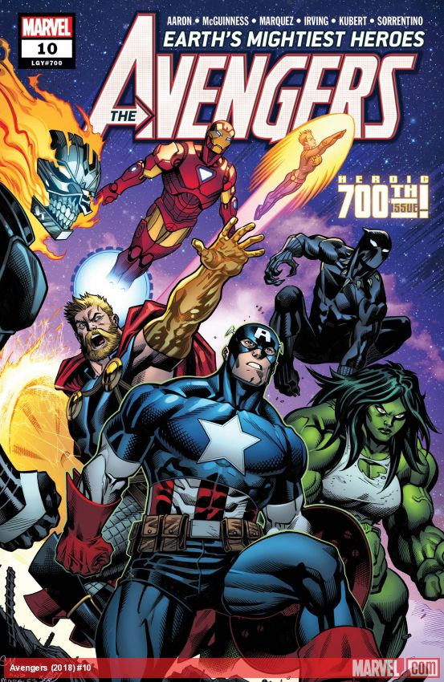







Marvel API
https://developer.marvel.com
Data for comics
Data for characters
and lot more…

Slide 18
Demo

Slide 19
Requirements breakdown

Slide 20
Requirements breakdown
Fetch marvel data from API (first time)
Display fetched data
Search

Slide 21
Fetched marvel data for the first time
Send request
Read response & response data
Extract data
Must be able to execute at multiple points of time

Slide 22
Display marvel data in UI
Create UI elements from data
Append all created UI elements to list
Must be able to execute at multiple points of time

Slide 23
Search
Listen/catch search
Fetch data with search string
Display fetched data
Clear UI list

Slide 24
Marvel API Access
Register a developer account at https://developer.marvel.com
Get BOTH Private Key & Public key
Token = Current Timestamp + Private Key + Public Key

Slide 25
Marvel Character Analysis
How to get ALL character data?
How to get their names?
How to get their images?
How to get the comics they are in?
How to get the events they are in?

Slide 26
Marvel Character Analysis
How to get ALL character data?
$.data.results
How to get their names?
$.data.results
Each result => .name
How to get their images?
$.data.results
Each result => .thumnail
thumbnail.path
thumbnail.extension

Slide 27
Marvel Character Analysis
How to get the comics they are in?
$.data.results
Each result => .comics
Each comic => name
How to get the events they are in?
$.data.results
Each result => .events
Each event => name

Slide 28
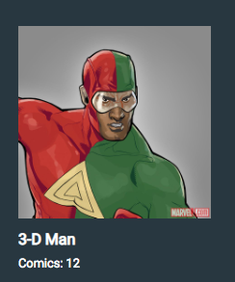
From data to UI
Data
UI
{
"id": 1011334,
"name": "3-D Man",
"description": "",
"thumbnail": {
"path": "http://i.annihil.us/...9784",
"extension": "jpg"
},
"comics": {
"available": 12,
"items": [ ... ],
}
}

Slide 29
Search
Same with fetch
The difference is search string
Input & Search button

Slide 30
Next steps

Slide 31
Next steps
Loading
Detail page
Other APIs
https://github.com/toddmotto/public-apis
Your own server

